Slide 1
How to Build a Free Website Portfolio Using Jekyll
Presented by The Undergraduate Researchers Interested In Data

Slide 2

What is Jekyll
Jekyll is a static site generator that can be used as a blog, a portfolio, or an informational website.
Jekyll is free and open-source. It’s relatively new and simple in nature.
Jekyll relies on Ruby, Markdown, and Git Pages.

Slide 3
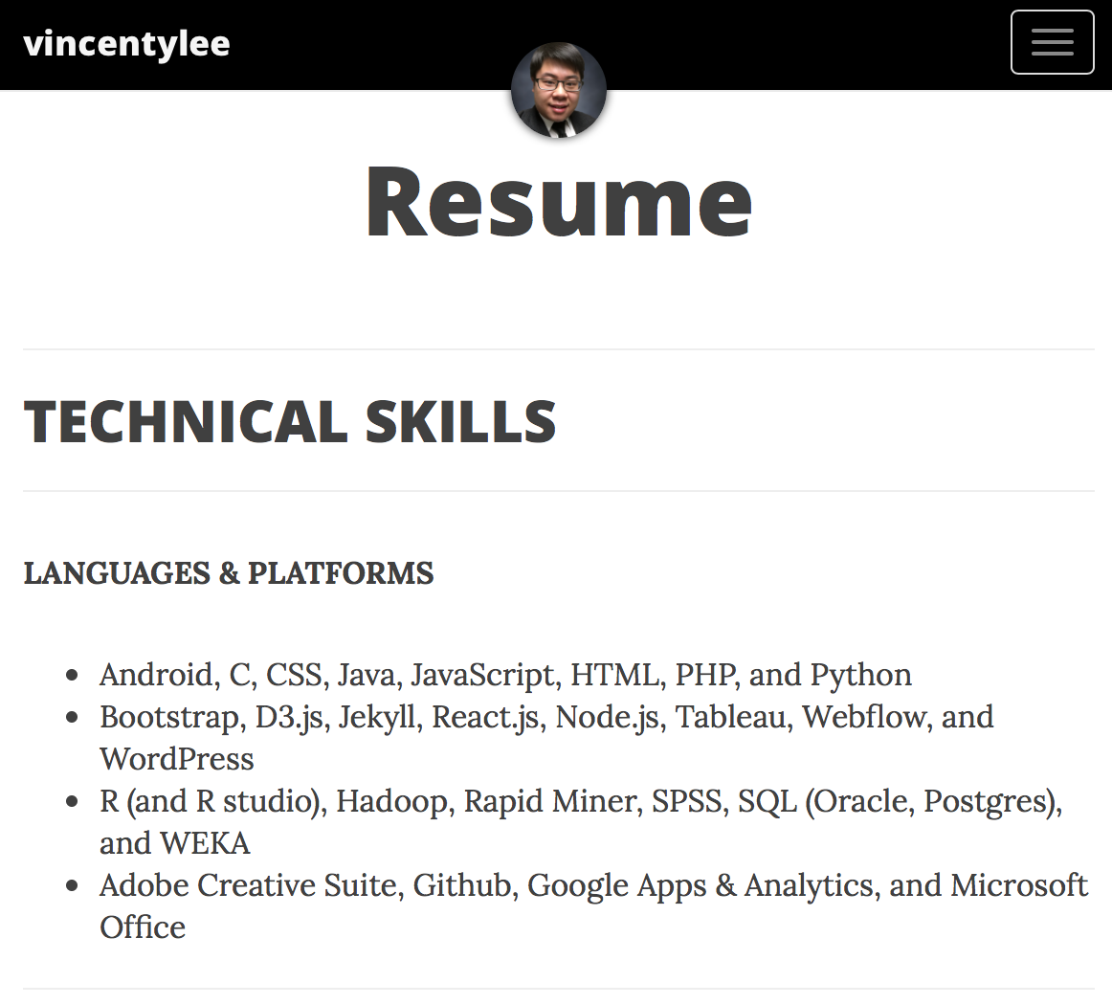

Examples of a Jekyll Website

Slide 4
What is a Static Webpage
Essentially you have a template + content = collection of HTML pages.
Basic and easy to develop, but lack dynamic features.
Does not have a database:
No login or user accounts
Relies on embedded content or plugins
Does not store or collect data

Slide 5
Benefits of a Static Website
Fast and responsive site
More secure because you have less to worry about
Less Maintenance and Management
Free / Low Cost by hosting it on Git Pages
Blog Aware & Markdown

Slide 6
Disadvantages of a Static Website
Does not include a database of dynamic features. In other words, it’s less functional as a website
Lacks the functionality to build an ecommerce system, bulletin / discussion boards, or ability for clients or users to upload documents
Does not have enough customization option and lacks search engine optimization or SEO.

Slide 7
Installing Jekyll (MACS)
Note: I am unable to help with resolving installation bugs or hardware issues
Find the terminal or your command prompt on your computer and open it. Download Ruby, Jekyll, and Bundler by by writing down this command in the terminal (to make sure it’s installed type e.g. filename -v):
sudo gem install ruby .
sudo gem install jekyll .
sudo gem install bundler .

Slide 8
Installing Jekyll (Windows)
Note: I am unable to help with resolving installation bugs or hardware issues
Find the terminal or your command prompt on your computer and open it. Download Ruby, Jekyll, and Bundler: http://jekyll-windows.juthilo.com
http://molevol.altervista.org/blog/install-jekyll-windows/?doing_wp_cron=1493481236.9909179210662841796875
Install Ruby .
gem install jekyll .
gem install bundler .

Slide 9
Creating a Local Server
Now let’s create a local server to give you an example of a plain jekyll website without any content or template design
cd Desktop .
jekyll new Portfolio .
cd Portfolio .
jekyll serve .
Go to your web browser and type “localhost:4000” in the URL

Slide 10
Finding a Jekyll Theme
Note: The Fancier Templates Require Specific Instructions and Ruby Gems
http://jekyllthemes.org
https://learn.cloudcannon.com/jekyll-templates/
Google “Jekyll Themes” or “Jekyll Templates”
Most if not all of these website templates are FREE

Slide 11
Creating a Github Account and Git Page
If you haven’t already create a github account
Once you’ve created your github account either clone or fork the template into your github account (note: if you haven’t synced your github account, it would be easier to fork the project over)
Now open the project that you’ve just copied over to you github
Go over to Settings and change the repository name
Change it to your username.github.io
Hooray! You’ve created your Git Page (you only get 1 Git Page per Account)

Slide 12
Making Changes
You can start adding your content via:
Github
Text Editor
Or R Studio with Github
It would help if you have some working knowledge of:
Github
HTML / CSS
Markdown
General Web Dev Skills

Slide 13
Understanding the Files
Different Files or Folders
config.yml: the most important information and setting for your website
post: Where you insert blog post using markdown
Img: All your images in a one collective folder
Ignore everything else for now
Creating a Markdown file
Read your test markdown file that is autogenerated on your website
Learn to add images, code snippets, links, etc.
2016-02-20-file_name.md (have this exact format)
Date | File Name | Markdown File

Slide 14
Publishing Changes onto your Website
If you have experience with github commands. Just commit and push all your changes online.
If you don’t have experience with github commands (you really should). Go to your github account and make changes there directly
Check your webpage at www.username.github.io
Refresh often to see the changes update

Slide 15
Creating a Domain Name
Everything from this point is completely free.
Normally you want to change your url link because it’s ugly.
To do that you need to buy a domain name (costs may vary):
https://www.godaddy.com/?ci=
Websites ending with .com, .net, .org are more expensive because they’re more recognizable and get better SEO results in google.
Don’t put your actual phone number because of telemarketers

Slide 16
Creating a Domain Name Continued
Go to Domain> Domain Settings> Manage DNS
Make sure to change the A and CNAME
If you have troubles go here: http://andrewsturges.com/blog/jekyll/tutorial/2014/11/06/github-and-godaddy.html
Also go over to your project in your github account
Create a new file called “CNAME”
Add your website name in the textbox and commit your changes

Slide 17
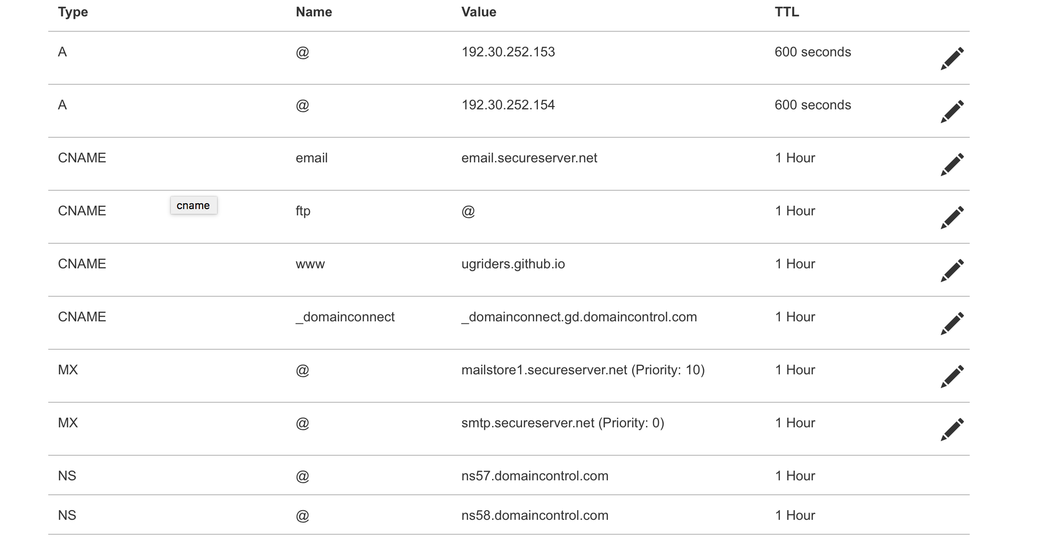
Example

Slide 18
You’re Done

